Slide 1
CS209: Computer Science II

Slide 2
Unit 2 Module 5:
Iterators
Introducing the Standard Template Library
Iterators
Basics
Constant and Mutable Iterators
Kinds of iterators
Examples
Iterator Efficiency

Slide 3
Introduction to the Standard Template Library
Standard Template Library (STL): a library containing templates for frequently used data structures and algorithms
Features are simply considered to be part of the C++ Standard Library
Not supported by many older compilers

Slide 4
Standard Template Library (STL)
The Standard Template Library defines powerful, template-based, reusable components
That implements common data structures and algorithms
STL extensively uses generic programming based on templates
Divided into three components:
Containers: data structures that store objects of any type
Iterators: used to manipulate container elements
Algorithms: searching, sorting and many others

Slide 5
STL
STL has containers, algorithms and Iterators
Containers hold objects, all of a specified type
Generic algorithms act on objects in containers
Iterators provide access to objects in the containers yet hide the internal structure of the container

Slide 6
Standard Template Library
Two important types of data structures in the STL:
containers: classes that stores data and imposes some organization on it (popular ‘templatized’ data structures)
iterators: like pointers; mechanisms for accessing and manipulating elements in a container

Slide 7
Standard Template Library
STL algorithms are functions that perform such common data manipulations as searching, sorting and comparing elements (or entire containers).
A container’s supported iterator type determines whether the container can be used with a specific algorithm.
Iterators encapsulate the mechanism used to access container elements. This encapsulation enables many of the STL algorithms to be applied to several containers without regard for the underlying container implementation.

Slide 8
Standard Template Library
The STL approach allows general programs to be written so that the code does not depend on the underlying container. Such a programming style is called generic programming.
An advantage of the STL is that you can reuse the STL containers, iterators and algorithms to implement common data representations and manipulations.

Slide 9
Standard Template Library
When programming pointer-based data structures and algorithms, we must do our own debugging and testing to be sure our data structures, classes and algorithms function properly.
It’s easy to make errors when manipulating pointers at this low level. Memory leaks and memory-access violations are common in such custom code. The prepackaged, ‘templatized’ containers of the STL are sufficient for most programmers.

Slide 10
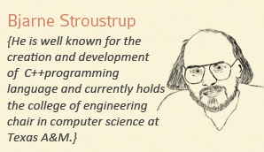
I say TGFSTL – thank goodness for the STL! But that’s why I have no friends…

Slide 11

Hey, that’s not funny. I am his friend, so be careful or you might encounter my null terminator.

Slide 12
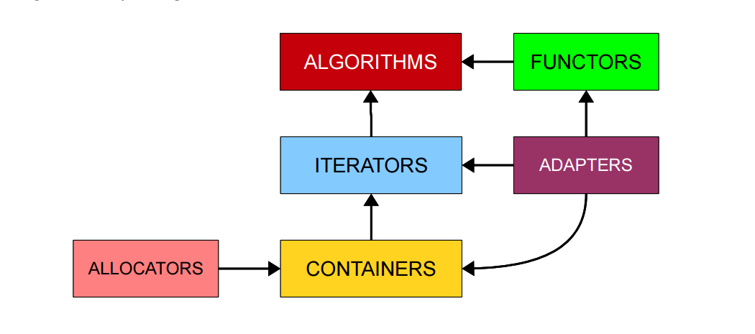
Algorithms
YOU ARE HERE

Slide 13
Using Declarations
Using declarations allow use of a function or name defined in a namespace:
using ns::fun( );
using ns::iterator;
using std::vector;
using std::vector<int> ::iterator;

Slide 14
Iterator Basics
An iterator is a generalization of pointer
Not a pointer but usually implemented using pointers
The pointer operations may be overloaded for behavior appropriate for the container internals
Treating iterators as pointers typically is OK.
Each container defines an appropriate iterator type.
Operations are consistent across all iterator types.

Slide 15
Iterator Basics
An iterator is a value that
Identifies a container and an element in the container
Lets us examine the value stored in that element
Provides operations for moving between elements in the container
Restricts the available operations in ways that correspond to what the container can handle efficiently

Slide 16
Basic Iterator Operations
Basic operations shared by all iterator types
++ (pre- and postfix) to advance to the next data item
If iterator i points to a particular element, then ++i points to the “next” element
* dereferencing operator provides data item access
*i refers to the element pointed to by i

Slide 17
Basic Iterator Operations
Basic operations shared by all iterator types
== and != operators to test whether two iterators point to the same data item
c.begin( ) returns an iterator pointing to the first element of container c
c.end( ) returns an iterator pointing past the last element of container c. Analogous to the null pointer. Unlike the null pointer, you can apply -- to the iterator returned by c.end( ) to get an iterator pointing to last element in the container.

Slide 18
More Iterator Operations
++ and -- (pre- and postfix) moves to next or previous data item Available to some kinds of iterators.
*p access may be read-only or read-write depending on the container and the definition of the iterator p.
STL containers define iterator types appropriate to the container internals.
Some containers provide read-only iterators
We use iterators with sequences (also called ranges). These sequences can be in containers, or they can be input sequences or output sequences.

Slide 19
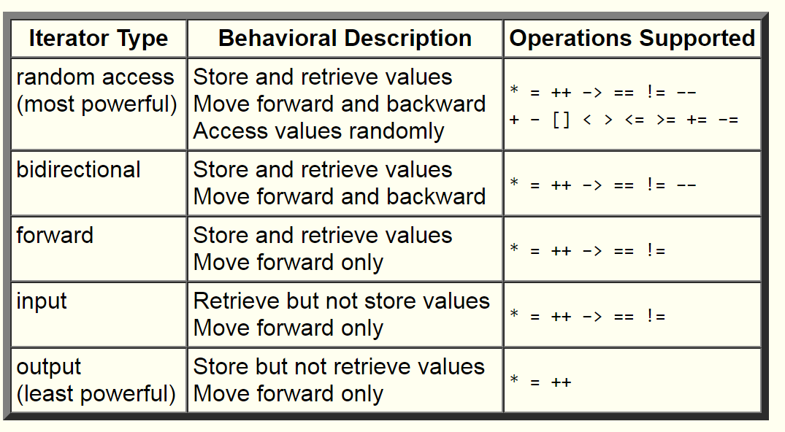
Strength of Iterators

Slide 20
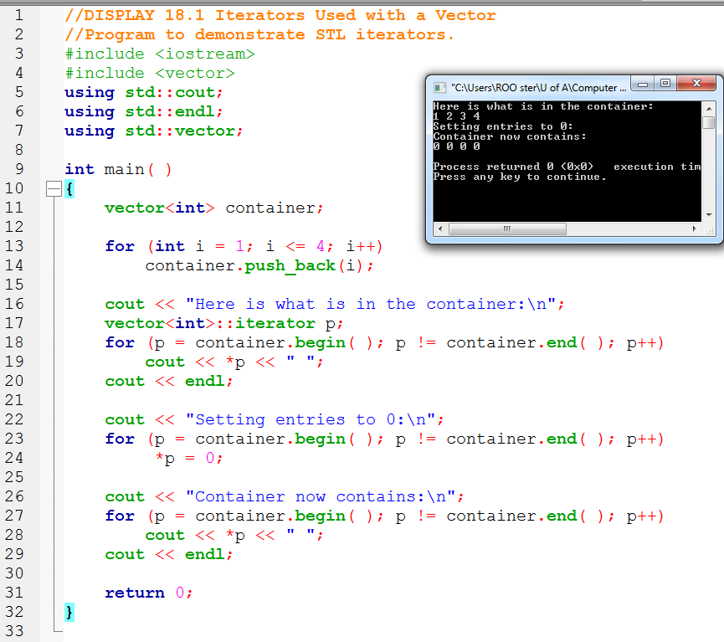
Four passes using
the iterator and we
end up with all zeroes

Slide 21
Constant and Mutable Iterators
Categories of iterator divide into constant and mutable iterator.
Constant Iterator cp does not allow assigning element at p
using std::vector<int>::const_iterator;
const_iterator cp = v.begin( );
*cp = something; // illegal
Mutable iterator p does allow changing the element at p.
using std::vector<int>::iterator;
iterator p = v.begin( );
*p = something; // OK

Slide 22
Constant and Mutable Iterators
Every standard container, such as vector, defines two associated iterator types:
container-type::const_iterator
container-type::iterator

Slide 23
Using auto
The C++11 auto keyword can simplify variable declarations for iterators, e.g. instead of:
vector<int>::iterator p = v.begin();
We simply use:
auto p = v.begin();

Slide 24
Kinds of Iterators
Forward iterators provide the basic operations
Bidirectional iterators provide the basic operations and the -- operators (pre- and postfix) to move to the previous data item.
Random access iterators provide
The basic operations and –
Indexing p[2] returns the third element in the container
Iterator arithmetic p + 2 returns an iterator to the third element in the container

Slide 25
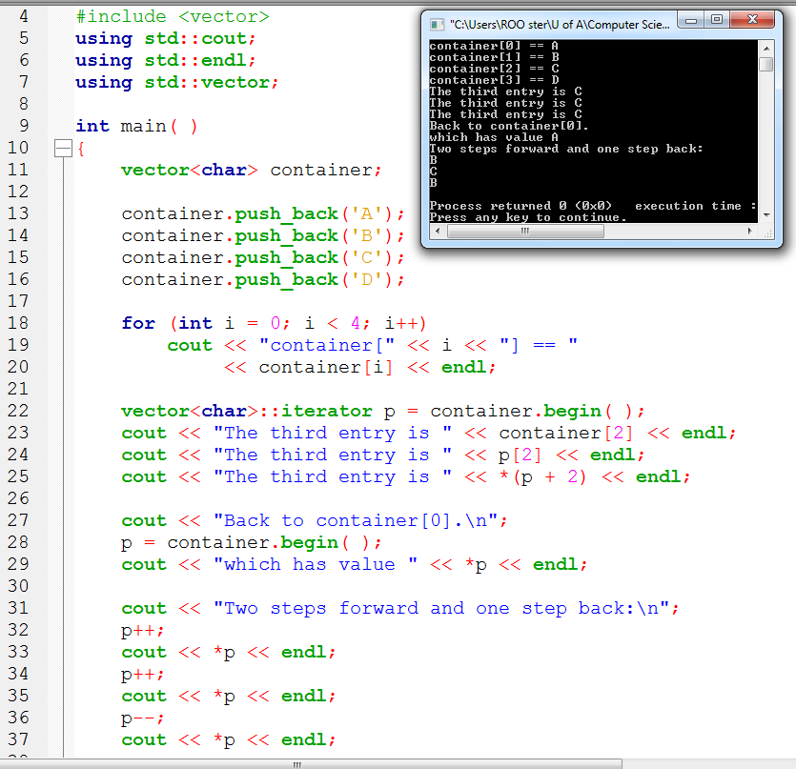
Notice the different ways to access the vector

Slide 26
Reverse Iterators
A reverse iterator enables cycling through a container from the end to the beginning. Reverse iterators reverse the more usual behavior of ++ and –
rp-- moves the reverse iterator rp towards the beginning of the container.
rp++ moves the reverse iterator rp towards the end of the container.
reverse_iterator rp;
for(rp = c.rbegin( ); rp != c.rend( ); ++rp)
process_item_at (rp);
Object c is a container with bidirectional iterators

Slide 27
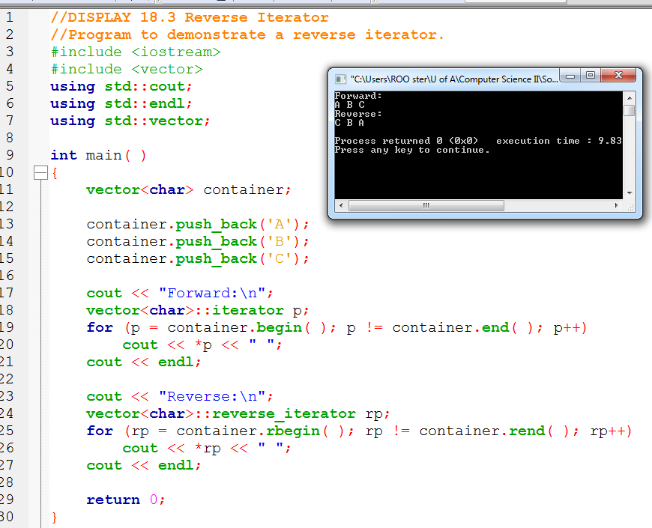

Slide 28
Other Kinds of Iterators
Two other kinds of (weaker) iterator –
An input iterator is a forward iterator that can be used with input streams.
An output iterator is a forward iterator that can be used with output streams.

Slide 29
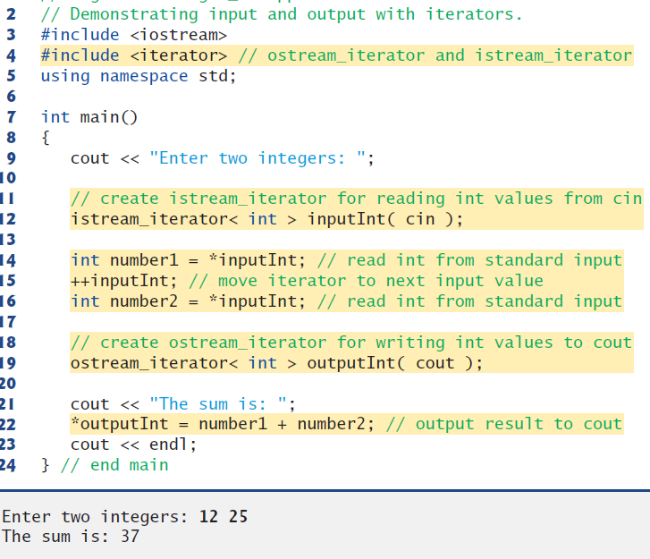
input from the standard input (a sequence of data for input into a program), using
an istream_iterator
output to the standard output (a sequence of data for output
from a program), using an ostream_iterator

Slide 30
Iterator operations summary
*it
Dereferences the iterator it to obtain the value stored in the container at the position that it denotes. This operation is often combined with . to obtain a member of a class object, as in (*it).x, which yields the member x of the object denoted by the iterator it. * has lower precedence than . and the same precedence as ++ and —.
it->x
Equivalent to (*it).x, which returns the member x denoted by the object obtained by dereferencing the iterator it. Same precedence as the . operator.

Slide 31
Iterator operations summary
++i
it++
Increments the iterator so that it denotes the next element in the container.
b == e
b != e
Compares two iterators for equality or inequality.

Slide 32
More iterator examples
struct Student_info
{
std::string name;
double midterm, final;
std::vector<double> homework;
};
…
vector<Student_info> students;
We will create an iterator, named iter,
that we'll use—in place of an index—to look at the elements in students

Slide 33
More Iterator examples
vector<Student_info>::const_iterator iter = students.begin();
iter != students.end();
++iter,
Set it to the value of the beginning
returns a value
that denotes (one past) the end of the container
2 types – const is
read only
the iterator so that it refers to the next element in students

Slide 34
More Iterator examples
for (vector<Student_info>::const_iterator iter = students.begin();
iter != students.end(); ++iter)
{
std::cout << (*iter).name << std::endl;
}
std::cout << iter->name << std::endl;
In order to execute correctly, this expression required parentheses that override the normal operator precedence

Slide 35
More Iterator examples
for (vector<Student_info>::const_iterator iter = students.begin();
iter != students.end(); ++iter)
{
std::cout << *iter.name << std::endl;
}
*(iter.name)
iter->name
Compiler error: iter does not have a member named name
Compiler treats it as seen
The arrow of combines these operations (syntax sugar)

Slide 36
More Iterator examples
for (vector<Student_info>::const_iterator iter = students.begin();
iter != students.end(); ++iter)
{
std::cout << iter->name << std::endl;
}

Slide 37
More Iterator examples
while (iter != students.end())
{
if (fgrade(*iter)) {
fail.push_back(*iter);
iter = students.erase(iter);
}
else {
++iter;
}
}
Push the item we are looking at in students onto fail (another vector we are using)
Now remove it from students
type iterator instead of const_iterator

Slide 38
More Iterator examples
while (iter != students.end())
{
if (fgrade(*iter)) {
fail.push_back(*iter);
iter = students.erase(iter);
}
else {
++iter;
}
}
iter can no longer refer to the same element because that element is gone
makes iter refer to the element after the erasure

Slide 39
Iterators and efficiency
Prefer const_iterators to iterators –
const_iterators are the STL equivalent of pointers-to-const. They point to values that may not be modified. The standard practice of using const whenever possible dictates that you should use const_iterators any time you need an iterator, yet have no need to modify what the iterator points to.
In maximally generic code, prefer non-member versions of begin, end, rbegin, etc., over their member function counterparts.

Slide 40
I say TGFSTL – thank goodness for the STL! But that’s why I have no friends…

Slide 41
References
Slide contributions include:
Walter Savitch, Problem solving with C++ (9th Edition). Addison-Wesley Longman Publishing Co., Inc. Boston, MA, USA ©2015
Gaddis, Starting Out with C++: From Control Structures through Objects, (8th Ed.) , Addison-Wesley Longman Publishing Co., Inc. Boston, MA, USA ©2015
Bjarne Stroustrup, The C++ Programming Language, 3rd Edition, Addison-Wesley Longman Publishing Co., Inc. Boston, MA, USA ©2007
Herb Sutter, Andrei Alexandrescu, C++ coding standards : 101 rules, guidelines, and best practices, Copyright © 2005 Pearson Education, Inc.
Paul Deitel & Harvey Deitel, C++ How to Program, (7th Ed.) © 2010 by Pearson Education, Inc.
Upper Saddle River, New Jersey 07458
Scott Meyers, Effective Modern C++. Copyright © 2015 (O’Reilly) , 978-1-491-90399-5.
Andrew Koenig and Barbara E. Moo, Accelerated C++ Practical Programming by Example,
Addison-Wesley, 2000 ISBN 0-201-70353-X

Slide 42
References
Slide contributions include:
Frank M. Carrano. Data Abstraction & Problem Solving with C++ (5th Edition)
Addison-Wesley Longman Publishing Co., Inc. Boston, MA, USA ©2006
TutorialsPoint - http://www.tutorialspoint.com/cplusplus/
Cplusplus.com - http://www.cplusplus.com/doc/tutorial/

